Slide 1

Security+ Guide to Network Security Fundamentals, Third Edition
Section 3
Wireless Network Security

Slide 2

TJX Data Breach
TJX used WEP security
They lost 45 million customer records
They settled the lawsuits for $40.9 million
  Link Ch 6a

Slide 3
Objectives
Describe the basic IEEE 802.11 wireless security protections
Define the vulnerabilities of open system authentication, WEP, and device authentication
Describe the WPA and WPA2 personal security models
Explain how enterprises can implement wireless security

Slide 4
IEEE 802.11 Wireless Security Protections

Slide 5
Institute of Electrical and Electronics Engineers (IEEE)
In the early 1980s, the IEEE began work on developing computer network architecture standards
  This work was called Project 802
In 1990, the IEEE formed a committee to develop a standard for WLANs (Wireless Local Area Networks)
  At that time WLANs operated at a speed of 1 to 2 million bits per second (Mbps)

Slide 6
IEEE 802.11 WLAN Standard
In 1997, the IEEE approved the IEEE 802.11 WLAN standard
Revisions
  IEEE 802.11a
  IEEE 802.11b
  IEEE 802.11g
  IEEE 802.11n

Slide 7
Controlling Access to a WLAN
Access is controlled by limiting a device’s access to the access point (AP)
Only devices that are authorized can connect to the AP
  One way: Media Access Control (MAC) address filtering
  CCSF uses this technique (unfortunately)
  See www.ccsf.edu/wifi

Slide 8
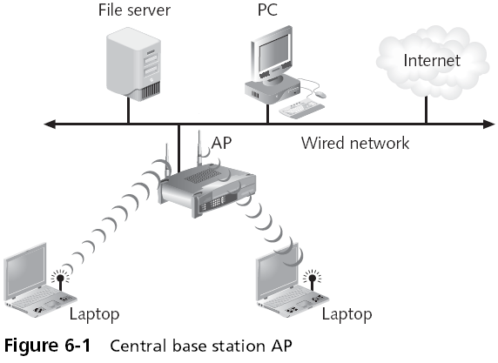
Controlling Access

Slide 9
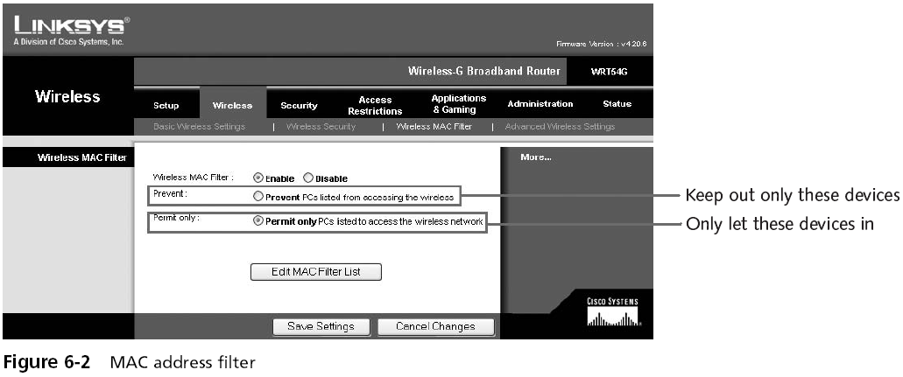
MAC Address Filtering

Slide 10
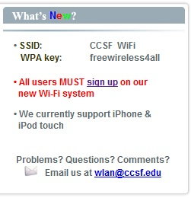
MAC Address Filtering
Usually implemented by permitting instead of preventing
CCSF does this
  www.ccsf.edu/wifi

Slide 11
Wired Equivalent Privacy (WEP)
Designed to ensure that only authorized parties can view transmitted wireless information
Uses encryption to protect traffic
WEP was designed to be:
  Efficient and reasonably strong
Security+ Guide to Network Security Fundamentals, Third Edition

Slide 12
WEP Keys
WEP secret keys can be 64 or 128 bits long
The AP and devices can hold up to four shared secret keys
  One of which must be designated as the default key

Slide 13
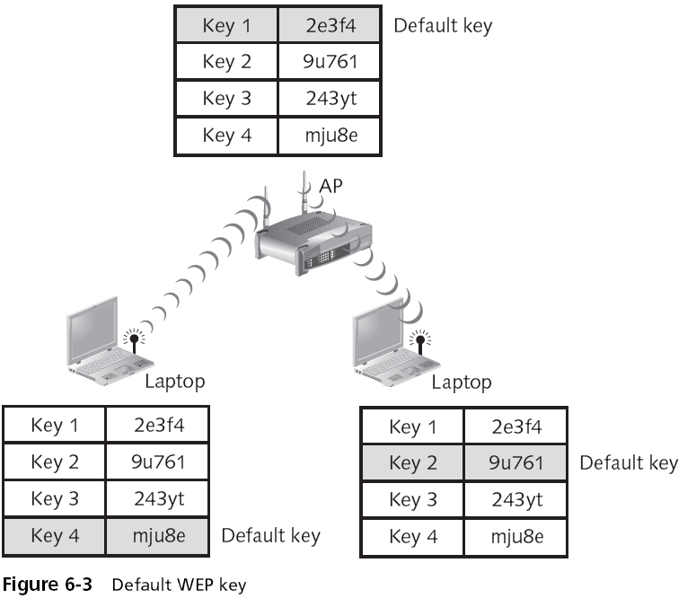

Slide 14
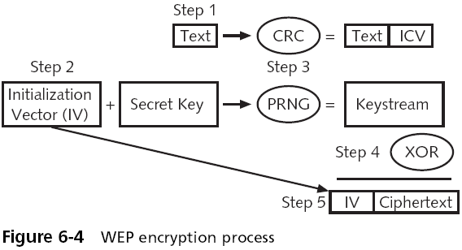
WEP Encryption Process

Slide 15
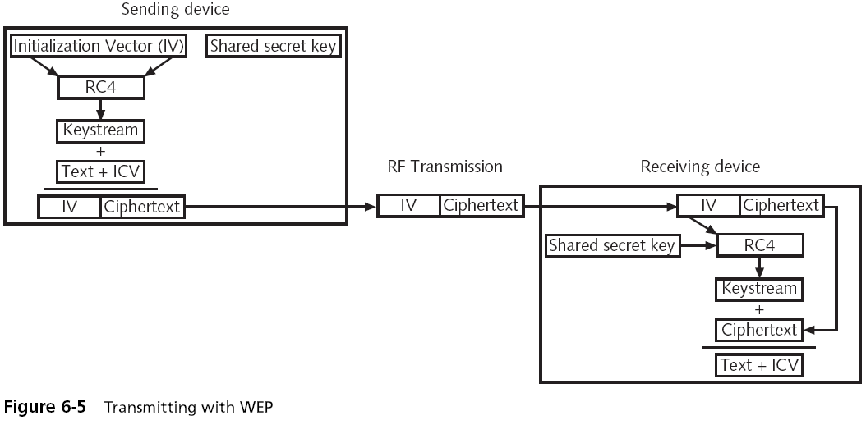
Transmitting with WEP

Slide 16
Device Authentication
Before a computer can connect to a WLAN, it must be authenticated
Types of authentication in 802.11
  Open system authentication
    Lets everyone in
  Shared key authentication
    Only lets computers in if they know the shared key

Slide 17
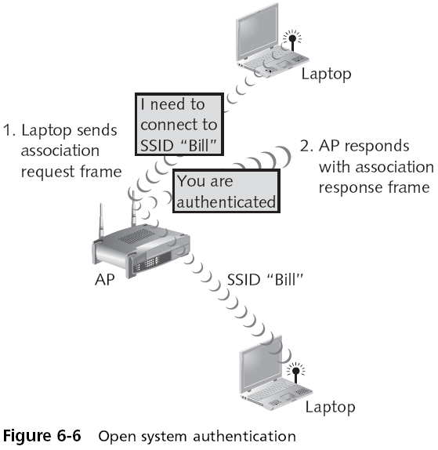

Slide 18
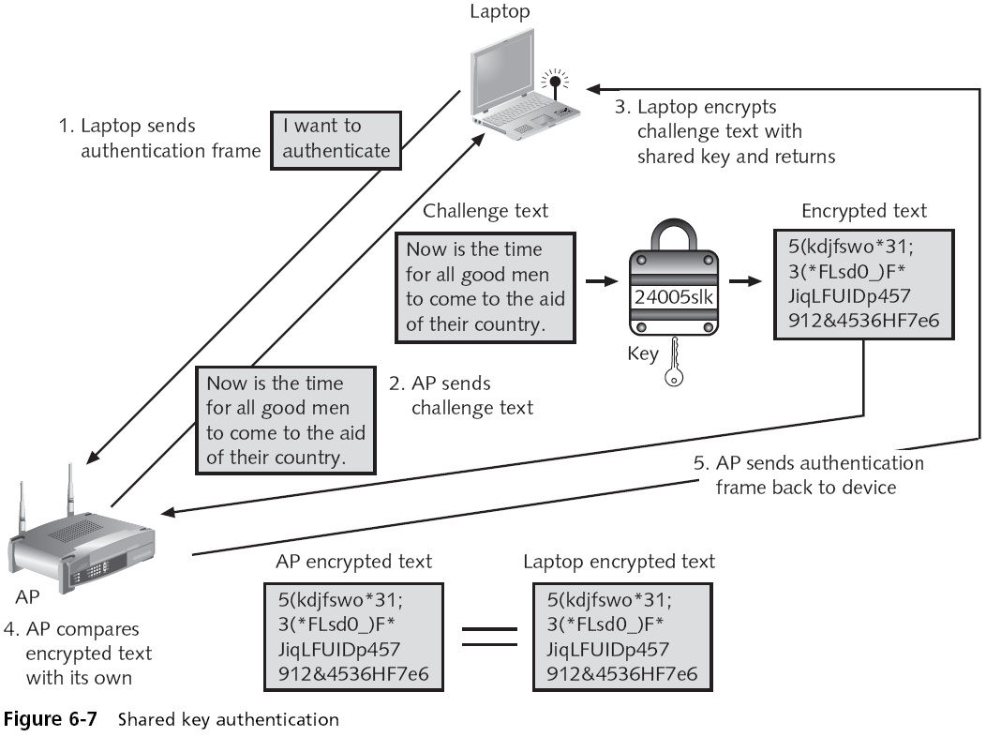

Slide 19
Vulnerabilities of IEEE 802.11 Security
Open system authentication
MAC address filtering
WEP

Slide 20
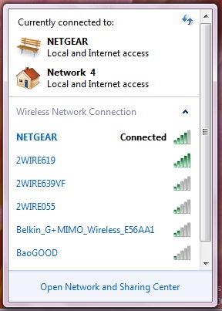
Open System Authentication
To connect, a computer needs the SSID (network name)
Routers normally send out beacon frames announcing the SSID
Passive scanning
  A wireless device listens for a beacon frame

Slide 21
Turning Off Beaconing
For "security" some people turn off beacons
  This annoys your legitimate users, who must now type in the SSID to connect
  It doesn't stop intruders, because the SSID is sent out in management frames anyway
  It can also affect roaming
  Windows XP prefers networks that broadcast

Slide 22
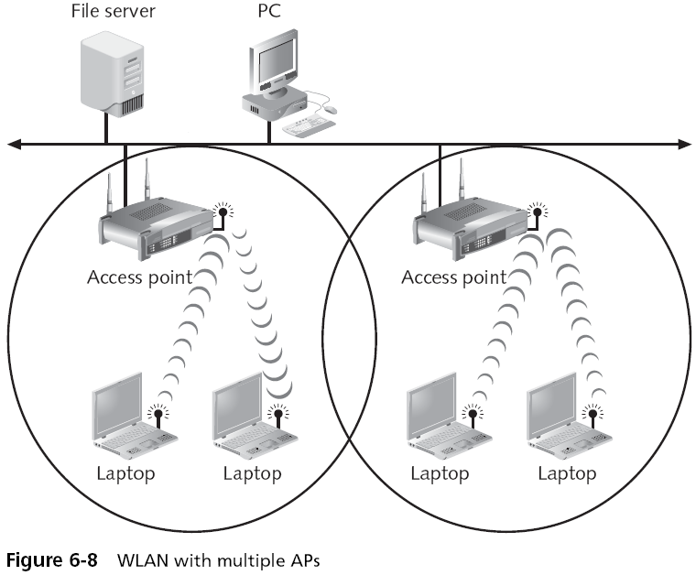

Slide 23
MAC Address Filtering Weaknesses
MAC addresses are transmitted in the clear
  An attacker can just sniff for MACs
Managing a large number of MAC addresses is difficult
MAC address filtering does not provide a means to temporarily allow a guest user to access the network
  Other than manually entering the user’s MAC address into the access point

Slide 24
WEP
To encrypt packets WEP can use only a 64-bit or 128-bit number
  Which is made up of a 24-bit initialization vector (IV) and a 40-bit or 104-bit default key
The 24-bit IV is too short, and repeats before long
In addition, packets can be replayed to force the access point to pump out IVs

Slide 25
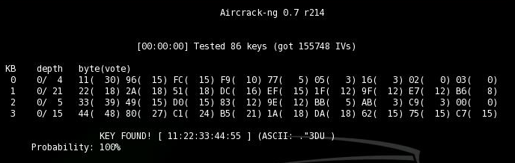
Cracking WEP
With the right equipment, WEP can be cracked in just a few minutes
  You need a special wireless card
  We do it in CNIT 123: Ethical Hacking and Network Defense

Slide 26
Personal Wireless Security
  WPA Personal Security
  WPA2 Personal Security

Slide 27
WPA Personal Security
Wireless Ethernet Compatibility Alliance (WECA)
  A consortium of wireless equipment manufacturers and software providers
WECA goals:
  To encourage wireless manufacturers to use the IEEE 802.11 technologies
  To promote and market these technologies
  To test and certify that wireless products adhere to the IEEE 802.11 standards to ensure product interoperability

Slide 28
WPA Personal Security
In 2002, the WECA organization changed its name to Wi-Fi (Wireless Fidelity) Alliance
In October 2003 the Wi-Fi Alliance introduced Wi-Fi Protected Access (WPA)
  WPA had the design goal to protect both present and future wireless devices, addresses both wireless authentication and encryption
PSK addresses authentication and TKIP addresses encryption

Slide 29
WPA Personal Security
Preshared key (PSK) authentication
  Uses a passphrase to generate the encryption key
Key must be entered into both the access point and all wireless devices
  Prior to the devices communicating with the AP
The PSK is not used for encryption
  Instead, it serves as the starting point (seed) for mathematically generating the encryption keys

Slide 30
Temporal Key Integrity Protocol (TKIP)
WPA replaces WEP with TKIP
TKIP advantages:
  TKIP uses a longer 128-bit key
  TKIP uses a new key for each packet

Slide 31
Message Integrity Check (MIC)
WPA also replaces the (CRC) function in WEP with the Message Integrity Check (MIC)
  Designed to prevent an attacker from capturing, altering, and resending data packets
  See link Ch 6b

Slide 32
WPA2 Personal Security
Wi-Fi Protected Access 2 (WPA2)
  Introduced by the Wi-Fi Alliance in September 2004
  The second generation of WPA security
  Still uses PSK (Pre-Shared Key) authentication
  But instead of TKIP encryption it uses a stronger data encryption method called AES-CCMP

Slide 33
WPA2 Personal Security
PSK Authentication
  Intended for personal and small office home office users who do not have advanced server capabilities
  PSK keys are automatically changed and authenticated between devices after a specified period of time known as the rekey interval

Slide 34
PSK Key Management Weaknesses
People may send the key by e-mail or another insecure method
Changing the PSK key is difficult
  Must type new key on every wireless device and on all access points
  In order to allow a guest user to have access to a PSK WLAN, the key must be given to that guest

Slide 35
Pre-Shared Key Weakness
A PSK is a 64-bit hexadecimal number
  Usually generated from a passphrase
    Consisting of letters, digits, punctuation, etc. that is between 8 and 63 characters in length
If the passphrase is a common word, it can be found with a dictionary attack

Slide 36
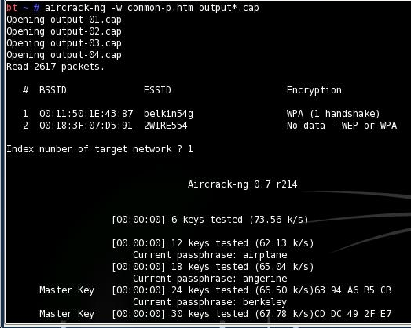
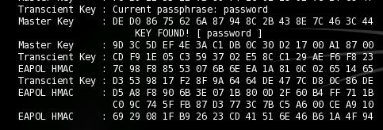
Cracking WPA

Slide 37
WPA2 Personal Security (continued)
AES-CCMP Encryption
  Encryption under the WPA2 personal security model is accomplished by AES-CCMP
  This encryption is so complex that it requires special hardware to be added to the access points to perform it

Slide 38
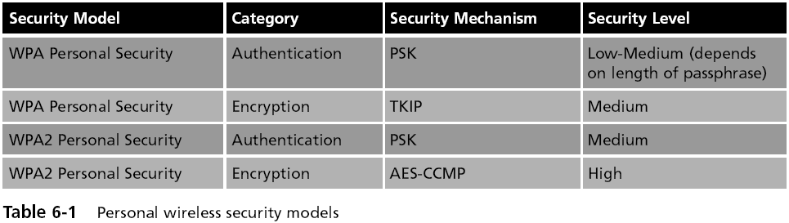
WPA and WPA2 Compared

Slide 39
Enterprise Wireless Security
Two models:
IEEE 802.11i
WPA and WPA2 models

Slide 40
IEEE 802.11i
Improves encryption and authentication
Encryption
  Replaces WEP’s original PRNG RC4 algorithm
  With a stronger cipher that performs three steps on every block (128 bits) of plaintext

Slide 41
IEEE 802.11i
IEEE 802.11i authentication and key management is accomplished by the IEEE 802.1x standard

Slide 42
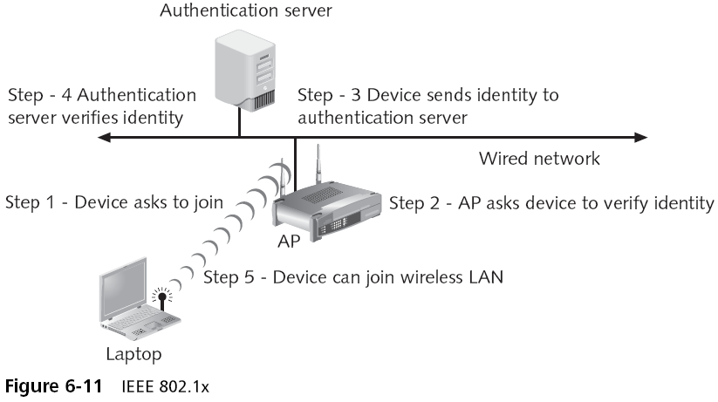
802.1x Authentication

Slide 43
IEEE 802.11i (continued)
Key-caching
  Remembers a client, so if a user roams away from a wireless access point and later returns, she does not need to re-enter her credentials
Pre-authentication
  Allows a device to become authenticated to an AP before moving into range of the AP
  Authentication packet is sent ahead

Slide 44
WPA Enterprise Security
Designed for medium to large-size organizations
Improved authentication and encryption
The authentication used is IEEE 802.1x and the encryption is TKIP

Slide 45
WPA Enterprise Security (continued)
IEEE 802.1x Authentication
  Provides an authentication framework for all IEEE 802-based LANs
  Does not perform any encryption
TKIP Encryption
  An improvement on WEP encryption
  Designed to fit into the existing WEP procedure

Slide 46
WPA2 Enterprise Security
The most secure method
Authentication uses IEEE 802.1x
Encryption is AES-CCMP

Slide 47
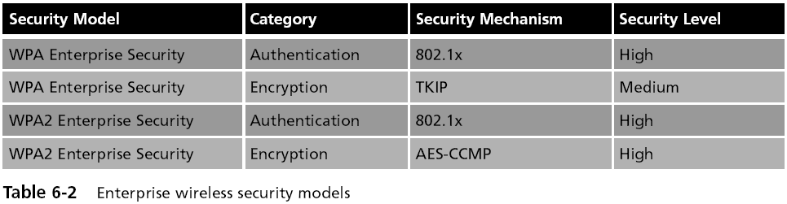
Enterprise and Personal Wireless Security Models

Slide 48
Enterprise Wireless Security Devices
Thin Access Point
  An access point without the authentication and encryption functions
    These features reside on the wireless switch
Advantages
  The APs can be managed from one central location
  All authentication is performed in the wireless switch

Slide 49
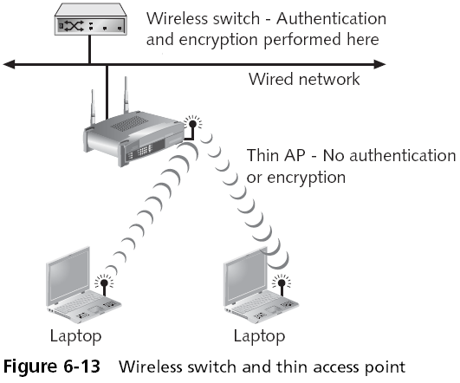
Enterprise Wireless Security Devices (continued)

Slide 50
Enterprise Wireless Security Devices (continued)
Wireless VLANs
  Can segment traffic and increase security
  The flexibility of a wireless VLAN depends on which device separates the packets and directs them to different networks

Slide 51
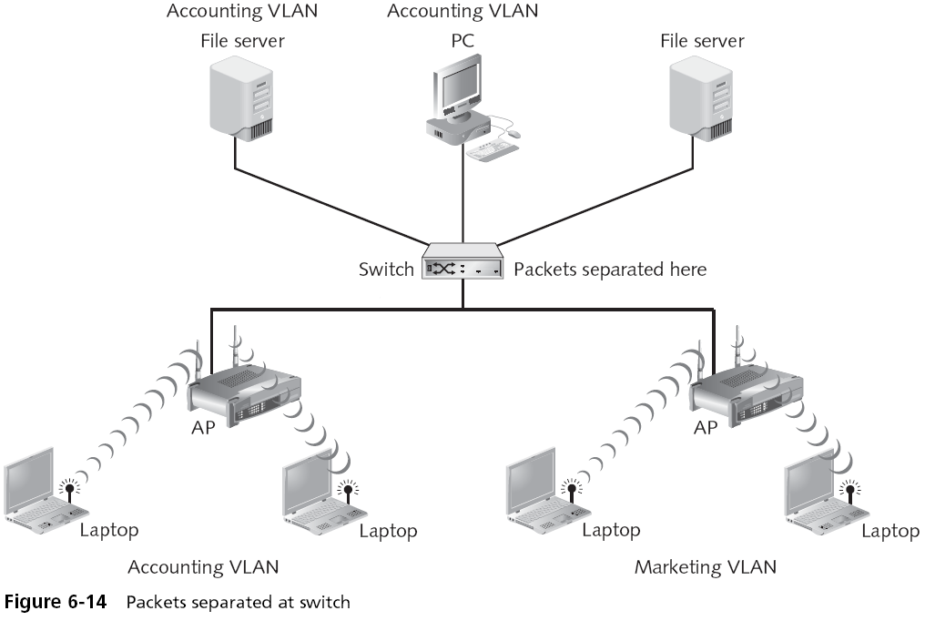

Slide 52
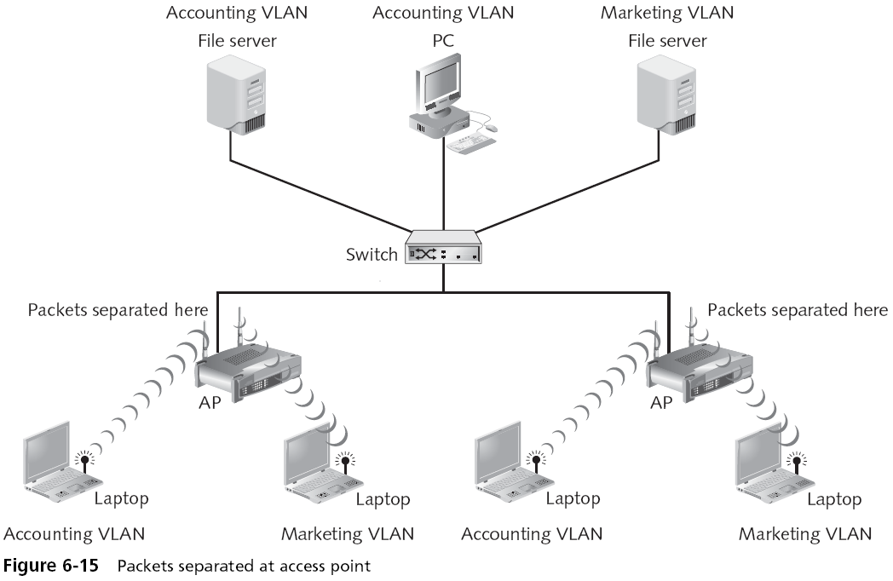

Slide 53
Enterprise Wireless Security Devices (continued)
For enhanced security, set up two wireless VLANs
  One for employee access
  One for guest access

Slide 54
Rogue Access Point Discovery Tools
Wireless protocol analyzer
  Auditors carry it around sniffing for rogue access points
For more security, set up wireless probes to monitor the RF frequency

Slide 55
Types of Wireless Probes
Wireless device probe
Desktop probe
Access point probe
Dedicated probe

Slide 56
